Slide 1
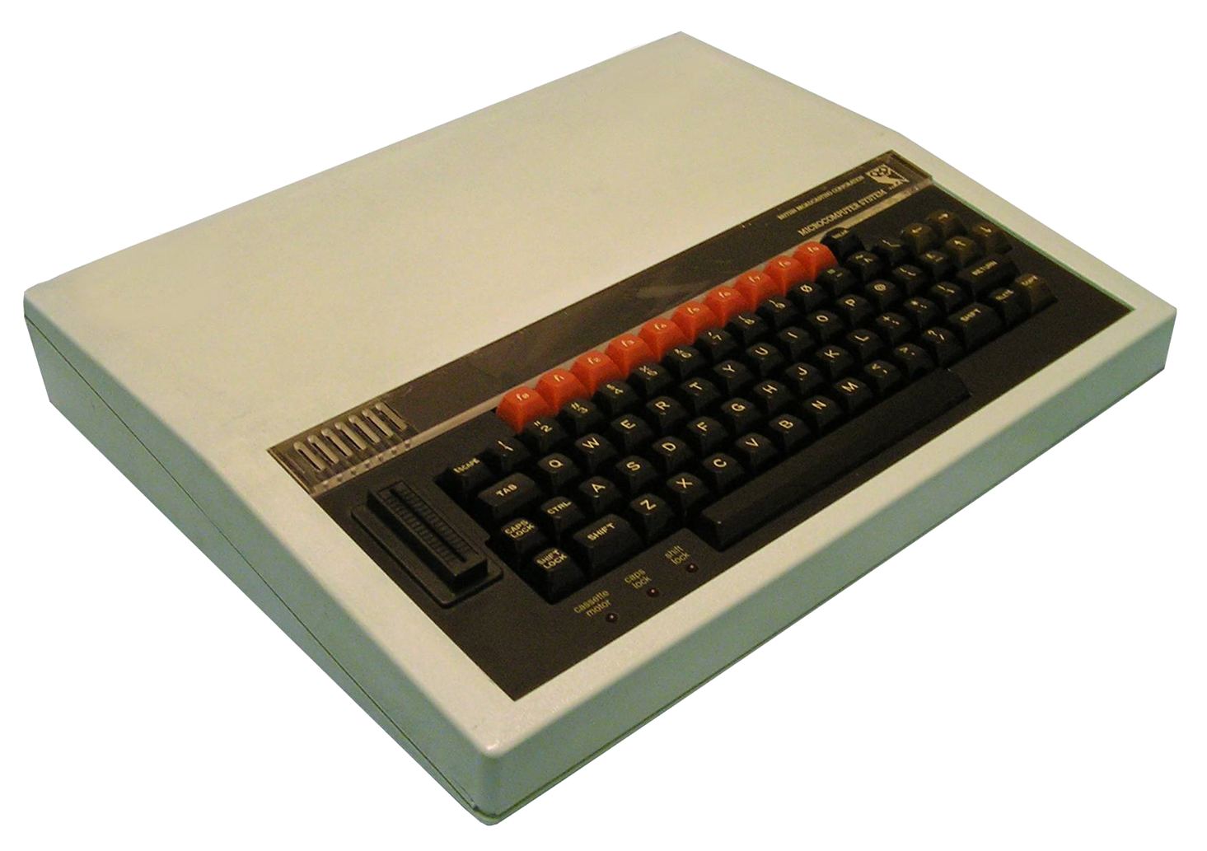
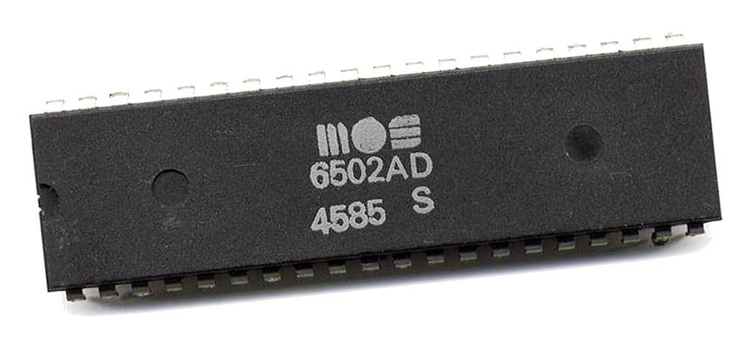

Towards Emulation of the BBC Micro Computer
Notes:
Towards as this is a first step!
Didn’t have time in innovation week – had a week off spent 3 days on this.
Going to try to hit a level here – much of the introductory section will be old hat for some of the audience but quite challenging for others, just depends on background

Slide 2
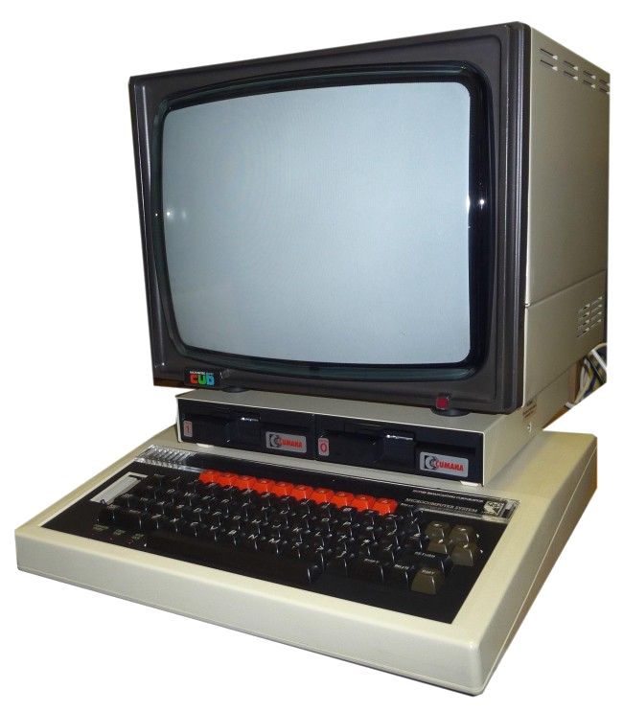
Some History
BBC Computer Literacy Project
Launched 1981
Manufactured by Acorn
2 MHz MOS Technology 6502/6512
RAM 16–32 KiB
Graphics - 6845 CRTC
8 Modes
160 × 256 8 Colours, 640 × 256 2 Colours, Teletext
Sound – Texas Instruments SN76489
Notes:
An accompanying 1982 television series, The Computer Programme, featuring Chris Serle learning to use the machine, was broadcast on BBC2.
If you are of a particular age and attended a UK state school likely you came across a BBC Micro.
Successor to the Acorn Atom (was to be the Proton)
Acorn – Acorn Risc Machines (ARM) fame!
My second computer at the age of ~ 14, so there’s some nostalgia there.
Also I the process of staring a pages of machine code to try to figure out what’s going on!
And to some degree this was inspired by seeing all of the Dino’s retro arcade boxes.
Machine way ahead of its time
Great computer to learn on – not least because even the shipped manual told you a lot about the guts of the OS and hardware
Teletext – Oracle and Ceefax – used unless lines in the TV broadcast signal to encode page content!

Slide 3
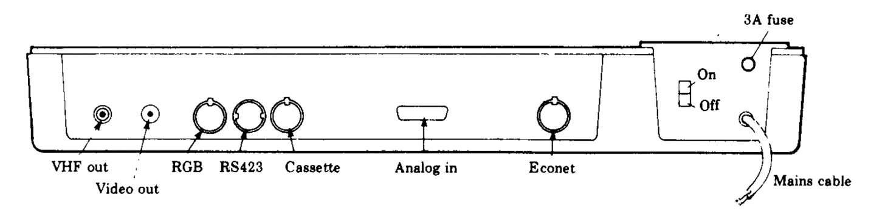
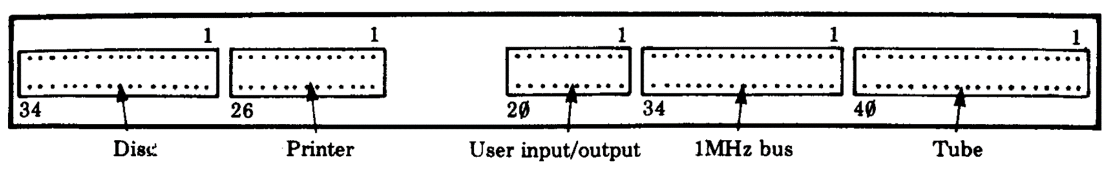
Expansion
Notes:
One stand out feature was it’s expandibility.
This shows the available ports
I’ll not go through them all
Do though take about the TUBE!

Slide 4
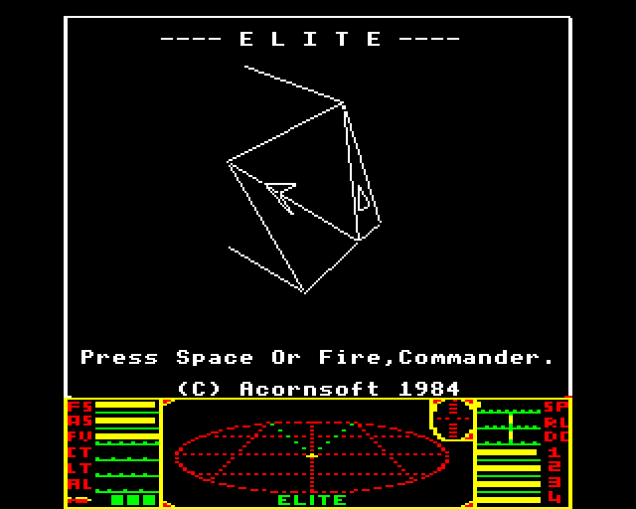
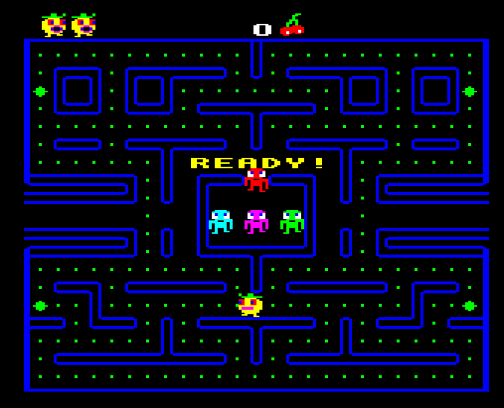
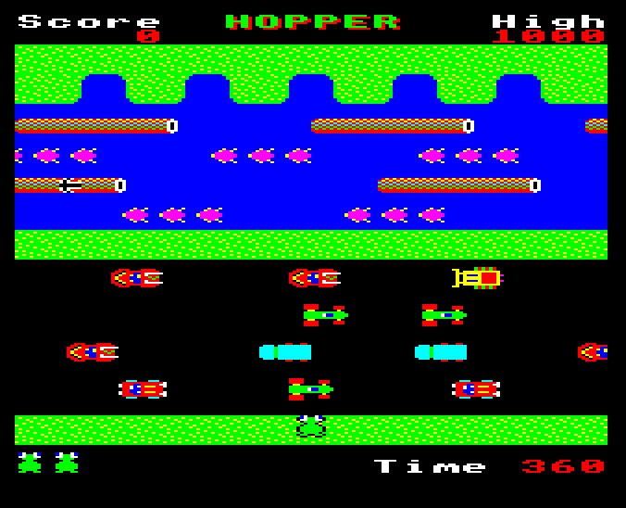
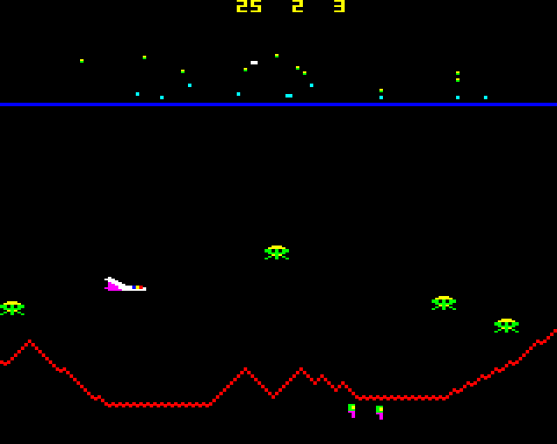
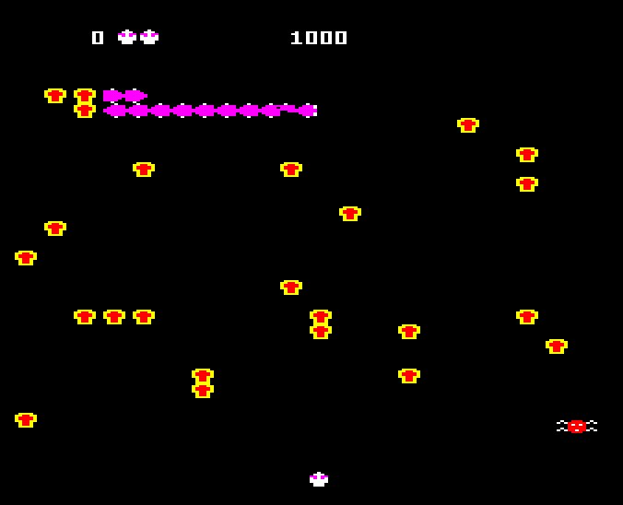
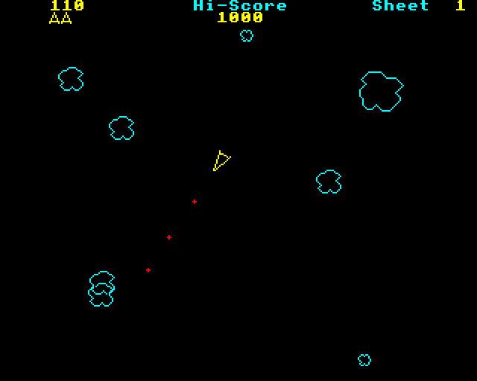
Software - Games
Elite
Pacman (Snapper)
Frogger (Hopper)
Defender (Planetoid)
Centipede (Bug Blaster)
Asteroids (Meteors)
Notes:
Even on this meagre hardware we were running full blown arcade games (hardware in the arcades was not so much better!)
Copies of lots of then contemporary arcade games with “we are not taking you IP honest names”
Elite though is an original and of particular note.
Space trading and fighting game
1000’s of locations
Full 3D graphics!

Slide 5
Software - other
Languages (ROMS)
Basic, Pascal, Forth, BCPL, LISP, Logo/Turtle graphics
Business
Word processors (Wordwise), Spreadsheet (ViewSheet), Accounting, Database
Educational
Maths, Physics, Electronics, Geography, Chemistry

Slide 6
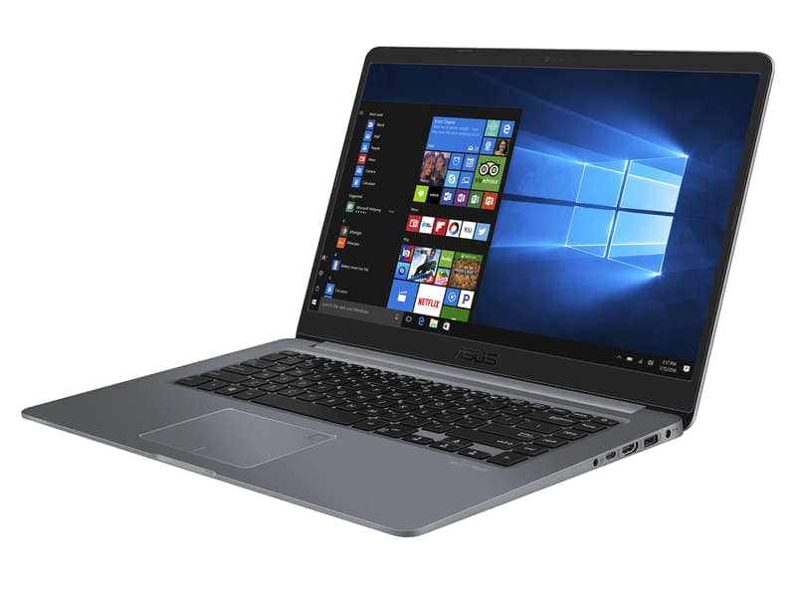
An Emulator you say…
Allows software written for one type of computer to run without modification on another…
… by recreating the hardware of the old system as software on the new system

Slide 7
Stage 1
#1 CPU
#4 Basic image loading
#2 Memory
#5 OS call Interception
#3 Basic I/O
Notes:
First steps:
CPU – The processor that actually executiosn the programmes
Memory – Of course to store programme state
Loading – We need to be able to load programmes somehow
OS Call interception – At this stage a least we need to be able to trap calls to the OS and divert them to our own “host” implemenentations.

Slide 8
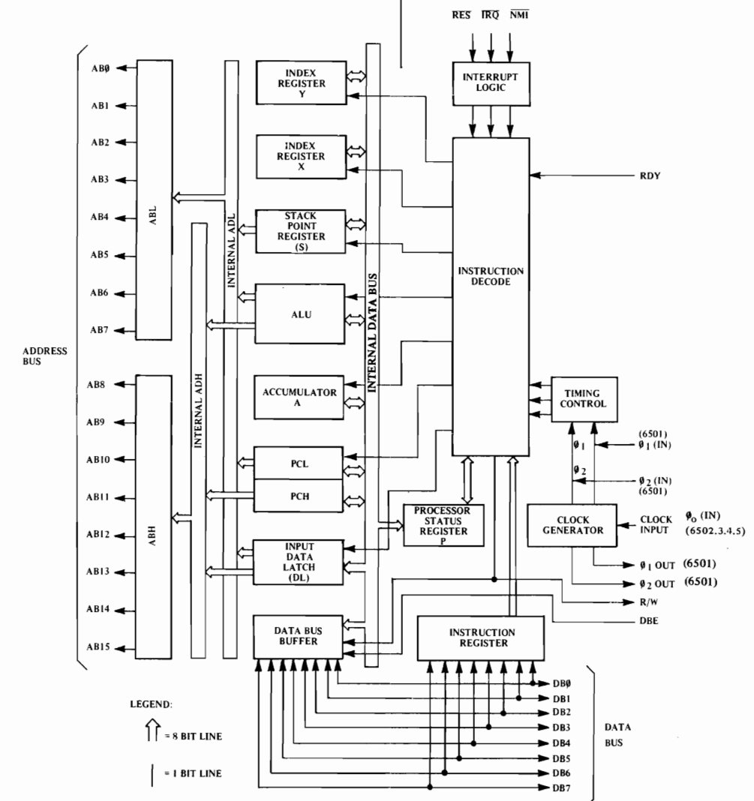
The 6502 Microprocessor
Clock speed – 2 MHz
Transistors - ~3500
Buses
Data – 8 bit
Address – 16 bit => 64K address space
Registers
1 Program counter (PC) 16 bit
1 Stack pointer (S) 8 bit => 256 byte hardware stack!
1 Status register (P)
1 Accumulator (A) 8 bit
2 Index registers (X,Y) 8 bit
Notes:
Explain what a bus is
Explain what a register is

Slide 9
Aside – comparison with a modern system
 | BBC (6502) | Modern Desktop (Intel) | Comment
Clock speed | 2 MHz | 4 GHz | x2,000
Size | 21 mm² | 100 mm² | x5
Transistors | 2500 | 16,000,000,000 | x6,400,000
Fabrication | 8 µm | 5 nm | ~1000
Word size | 1 Byte | 8 Bytes | x8
Cores | 1 | 4(8)+ | x4(x8)
L1/L2/L3 cache | 0 | 64K/256K/2M x 4 | -
Memory | 32K | 32G | x1,000,000
Notes:
Walk through some of the stats
It is interesting to note the orders of magnitude of improvement here.
And how much waste we now have with layers on layers.

Slide 10
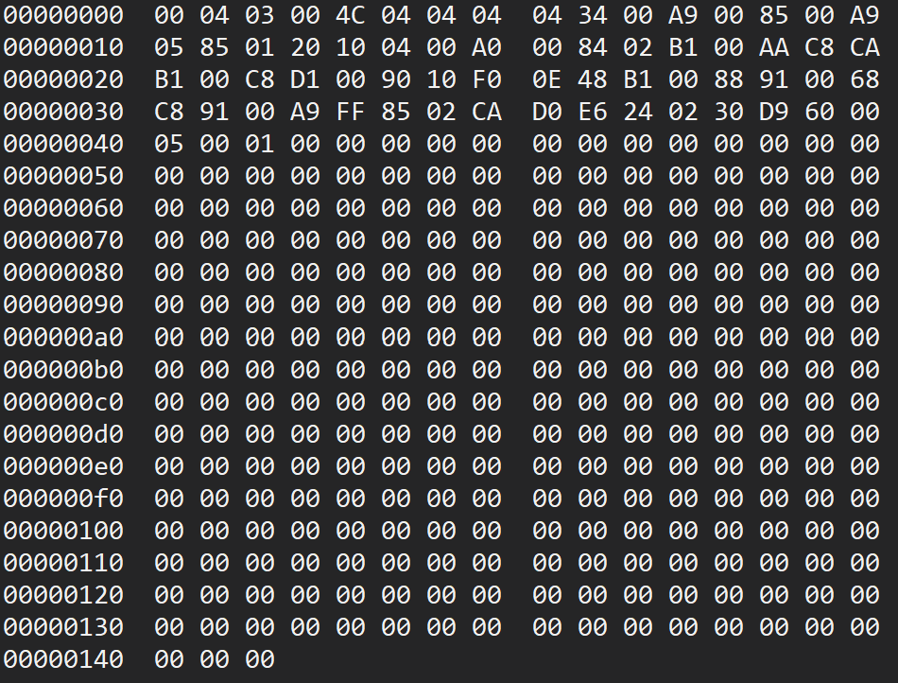
Programming the CPU
Machine Code
When you run any application, this is the code the computer is actually executing!
Lowest level of software
Binary language processed directly by the CPU
Simple instructions
Load a value in to register
Jump to an address
Add two 8 bit numbers
Branch depending on value of status flag
Notes:
Machine code is the actual language of the CPU
It’s the bunch of 1’s and 0’s the machines is actually interpreting when you run any programme – no matter the high level language it is written in.

Slide 11
Structure of an Instruction
OpCode => What to do
Load a value into the Accumulator
Encoded together in 1 byte
Addressing mode => How to resolve the operand
You’ll find the address of the value to load in the next two bytes
0 to 2 bytes depending on addressing mode
Operand => What act on
The address of the value to load
Notes:
If break down those machine code instructions this is how they are composed:

Slide 12
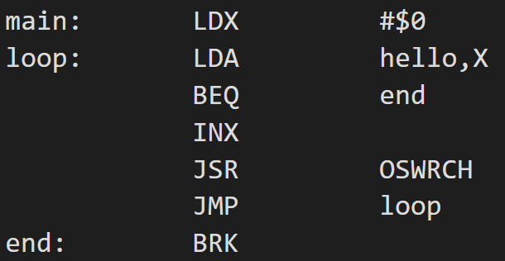
Programming the CPU
Assembly Language
Operand & addressing mode
Label
Op code
Human readable form of machine code
1:1 correspondence with machine code
This is NOT a higher-level language
An assembler translates assembly language into machine code for execution
Notes:
Thankfully we do not need to code directly in the binary language of machine code

Slide 13
6502 MC/Assembly Language
56 Op Codes
13 Addressing Modes
CLC – Clear the Carry flag
LDA – Load accumulator
INX – Increase X
ADC – Add to the accumulator
BEQ – Branch if Zero flag is set
ROR – Rotate bits right
JSR – Jump to a subroutine
Implicit - CLC
Accumulator – LSR A
Immediate – LDA #10
Zero-page – LDX $10
Zero-page, X – AND $20, X
Zero-page, Y – STX $30, Y
Relative – BEQ $26
Absolute – JMP $20FE
Absolute, X – STA $3000, X
Absolute, Y – AND $2000, Y
Indirect - JMP ($FFCC)
Indexed Indirect - LDA ($40), A
Indirect Indexed – LDA ($40, A)

Slide 14
Tool Chain & Execution Process
Assembly Language
6502 Emulator
LDA ($00),Y
BEQ $07
Image loader
Memory
6502 cross assembler
$B1 $00
$F0 $07
Basic I/O
6502 Emu
Machine Code
Keyboard
Screen
Notes:
So when we want to run one of these assembly language programmes on our emulator things appear as here
Starting from the assembly language programme
We assemble it using a cross compiler on Windows
This creates the 6502 machine code
We then load this image into the emulator memory
And point the emulated 6502 process at it and begin execution.

Slide 15
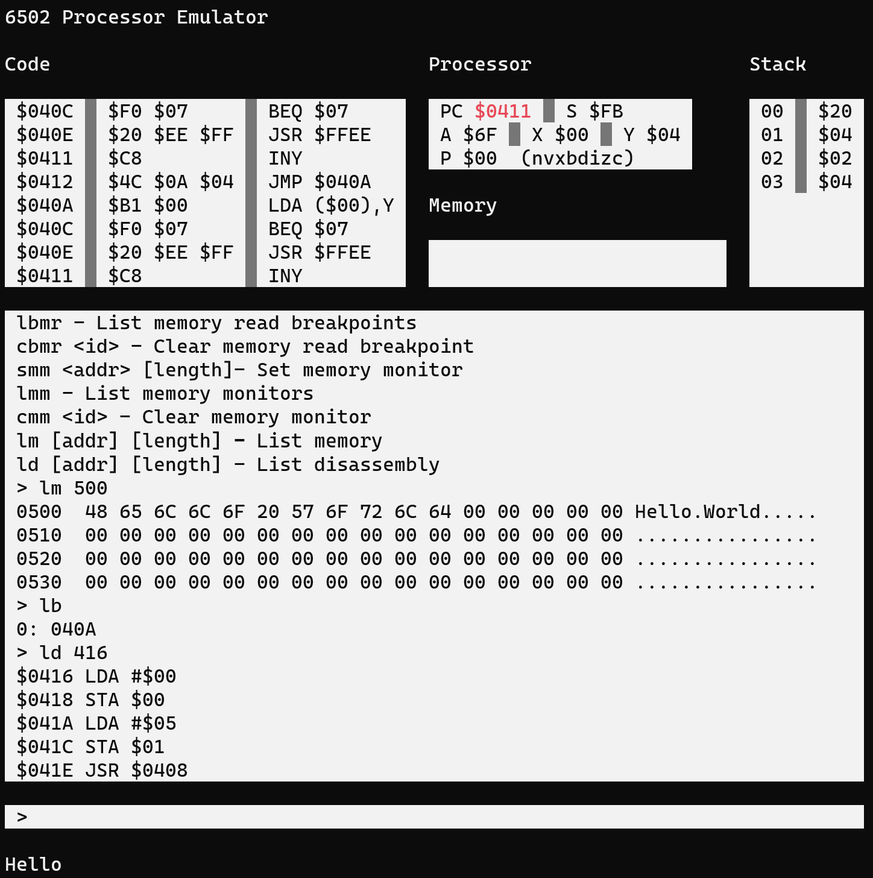
6502 Debugger
Processor Registers
Hardware stack
Disassembly
Memory writes
Functions
Command output
Load DASM images
Load core dumps
Single step
Step over
Disassembly
Memory inspection
Set reg/mem
Break points
Run until RTS
Programme output
Notes:
As part of the work I also developed a debugger
Which allows us to inspect and control the execution of the machine code in the emulator.
Go through the windows
I’ll use that to demonstrator the 6502 emulation.

Slide 16
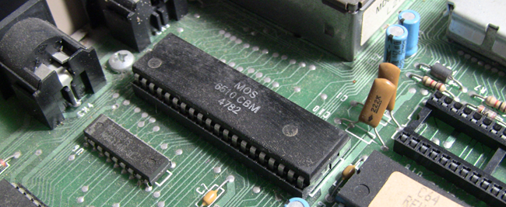
Demo #1 – 6502 Emu & Debugger

Slide 17
Stage 2 – From 6502 to BBC Micro (partial emulation)
#4 OS Boot
#1 6845 CRTC Simple Mode 7
#5 Execution of BBC BASIC programmes
#2 OS ROM loading
#3 Paged ROM loading
Notes:
Now for the second stage – well really more 1.5
This is to actually get us to the point of running the BBC Operating system and simple programmes on the emulator
No graphics
LOTS of frigs that will need to be sorted later.

Slide 18
BBC Micro Emulation
6502 Emulator
Boot/6502 Reset
BBC Basic Programme
JMP (0xFFFC)
10 REM Input a number
20 REPEAT
30 PRINT “Enter "
40 INPUT N
50 UNTIL N >= 0 AND N <= 9
60 PRINT "Thank You"
OS ROM
0xFFFF
0xC000
BBC Basic ROM
$BFFF
$8000
6845 CRTC Emulator
Memory Mapped Screen
$7FFF
Mode 7 (Teletext)
$7C00
Scan
Working Memory
$7BFF
Render
$0000
>
Notes:
Note the elements in the diagram
OS ROM
Page ROM – one of the language ROMs we mentioned
Memory mapped screen
CRTC scanning
Keyboard emulation
Jump via rest vector (hard wired into 6502)
Then in theory we should be able to run simple BBC basic programmes

Slide 19
A Different Viewpoint
Native BBC BASIC
BBC Basic programme
Native 6502 MC
Basic interpreter
Native 6502 MC
BBC OS
Hardware emulation
6845 CRTC
6502 CPU
Keyboard interface
C#/.Net Core
IL
X86 MC
JIT
Windows OS
X86 CPU

Slide 20
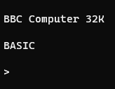
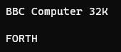
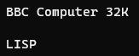
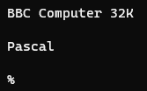
Demo 2 – Simple BBC Emu

Slide 21
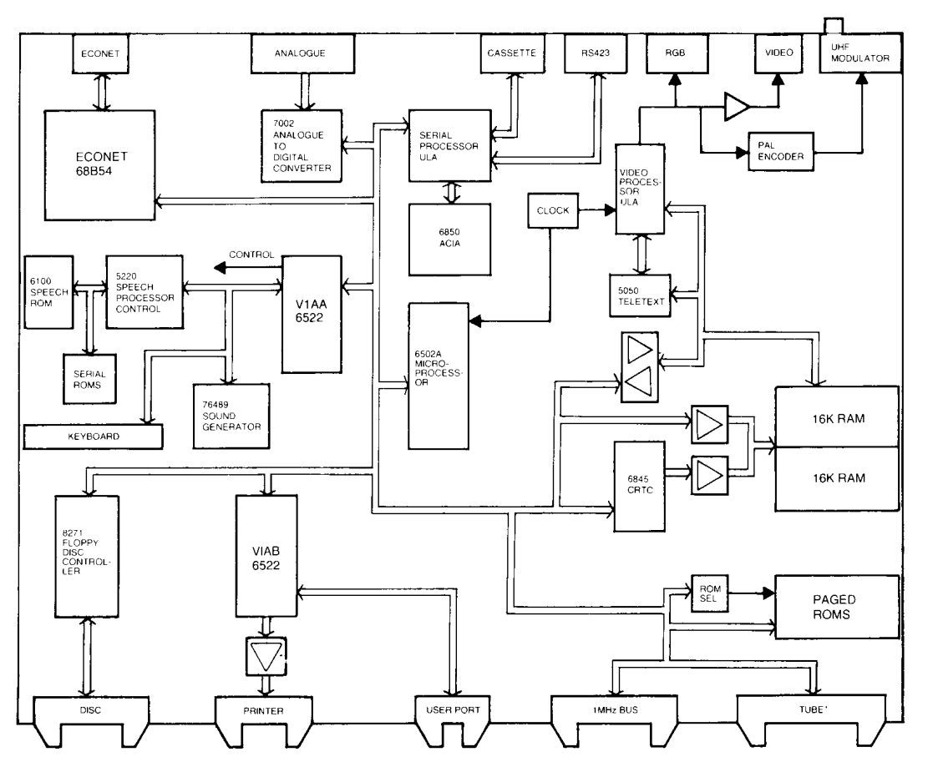
Status & What's Next
Done
Required
Unsure
From the BBC Microcomputer Advanced User Guide
Notes:
Go through what’s needed
Next steps
Graphics working (better 6845 CRTC)
Interrupts – e.g. timers, screen refresh, key presses
VIA + Keyboard
Sound generator
I plan to do some follow on work
And I’ll give updates in these meetings if there is any interest – or even if there is not!

Slide 22

?

